Slide 1

Using Softmax and Cross Entropy in a NN – Derivatives
Gates
Reference: https://towardsdatascience.com/derivative-of-the-softmax-function-and-the-categorical-cross-entropy-loss-ffceefc081d1

Slide 2
Topics and Reminders
Topics
The Derivative of the Softmax
The Jacobian
The Categorical Cross-Entropy Loss Function
Blending Softmax with Cross Entropy
The Final dL/dz for weight/bias updates
Notes
Our last activation function to create the Y^ values will be the Softmax.
Our Loss (AKA Error or Cost) function will be the Categorical Cross Entropy.
Our Y is hot-encoded.
NOTE: Most images in this slide deck are borrowed from Thomas Kurbiel (published in Towards Data Science)

Slide 3
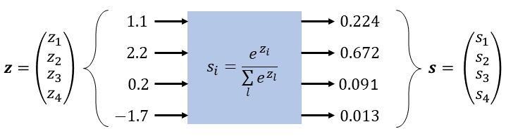
Applying the Softmax
This image shows the Softmax transformation of a single 4-class output. Here, z1 is category 1, z4 is category 4, etc.
Y^
The s values are non-negative
Values (s1, ..sn) sum to 1
Values lie between 0 and 1

Slide 4
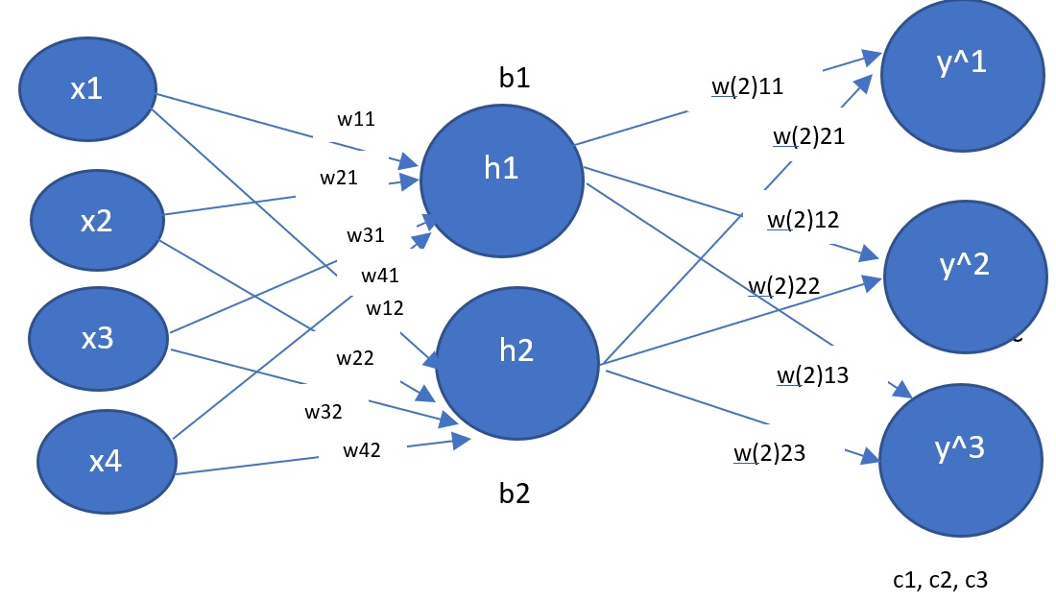
Z2 = [ h1w(2)11 + h2w(2)21 + c1 h1w(2)12 + h2w(2)22 + c2 h1w(2)13 + h2w(2)23 + c3 h1w(2)11 + h2w(2)21 + c1 h1w(2)12 + h2w(2)22 + c2 h1w(2)13 + h2w(2)23 + c3 ]
In this presentation, “z” will be used to describe the linear equations used to create Y^.
Note also that “s” will be used to describe softmax(z).
Y^ = S(Z2)
Example:
Y^1 = S(z1)

Slide 5
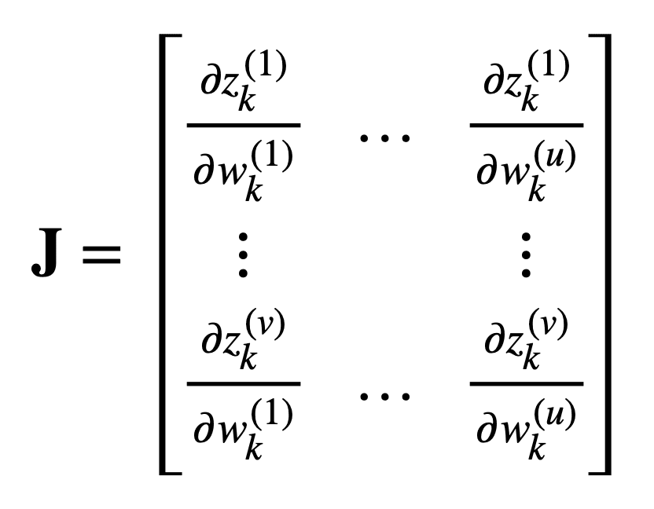
Jacobian matrix
Jacobian is often interchangeably used to refer to both the Jacobian matrix or its determinant.
The Jacobian matrix collects all first-order partial derivatives of a multivariate function that can be used for backpropagation.

Slide 6
Overall Goals
1) Compute the Jacobian matrix of the softmax function.
2) Compute the gradient of the categorical cross-entropy loss for backpropagation.
Good news –
Because we are using one-hot encoding, softmax, and categorical cross entropy together, the solution will be very simple.

Slide 7


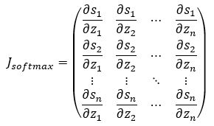
Derivative Softmax Function
The softmax function is a vector function, which takes a vector as input and produces a vector as output:
This Jacobian represents the set of partial derivatives for the softmax applied to a predicted output vector and with respect to calculating the derivative of the Loss function.

Slide 8

Step 1: Logarithmic Derivative
1) Each output of the softmax function depends on all the input values
2) For this reason the off-diagonal elements of the Jacobian aren’t zero.
3) Since the outputs of the softmax function are strictly positive values, we can take the partial derivative of the log of the output (also called “logarithmic derivative”) to simplify the derivative.

Slide 9



Math Part 1
Rearrange the terms
Let’s work on this part first for a few slides, and then we will multiply the si
Therefore….

Slide 10



So far, we are here:
NOTE:
This is called an indicator function. It is “1” here when I = j and 0 otherwise

Slide 11


From here:

Slide 12


Recall that 1{i = j} means that this is 1 when i = j and 0 otherwise.
Recall that we are trying to find this:

Slide 13
But- do not panic!
Because we are using one-hot encoding and categorical cross-entropy, our derivative will simplify – A LOT!

Slide 14

Notes about Categorical Cross-Entropy
1) The categorical cross-entropy loss is exclusively used in multi-class classification tasks.
2) Each sample (input vector) belongs to (represents) exactly ONE class (or category)
3) The label (Y) is one-hot encoded and so is a vector of size C (C is for category)/
Recall – for a 4-class problem:

Slide 15

Cross Entropy
Takes as input, two discrete probability distributions (whose elements lie between 0 and 1 and sum to 1) and outputs a single real value (a measure of the entropy between the vectors).
The smaller the cross-entropy, the more similar the two probability distributions are.

Slide 16
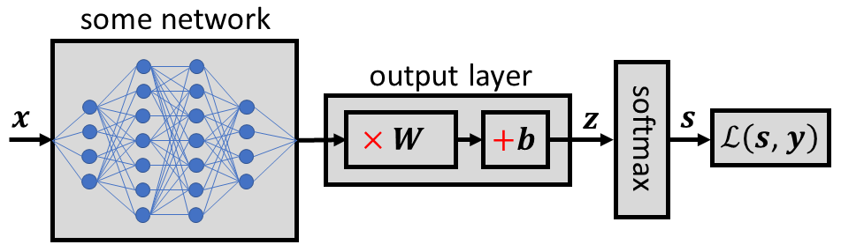
Softmax as the final activation function

Slide 17



For Backpropagation, we need…
Recall, our Loss function is:
Recall

Slide 18




And Finally….
Recall that “s” is our y^
the one-hot encoded vector 𝒚 sums to 1

